Slide 1
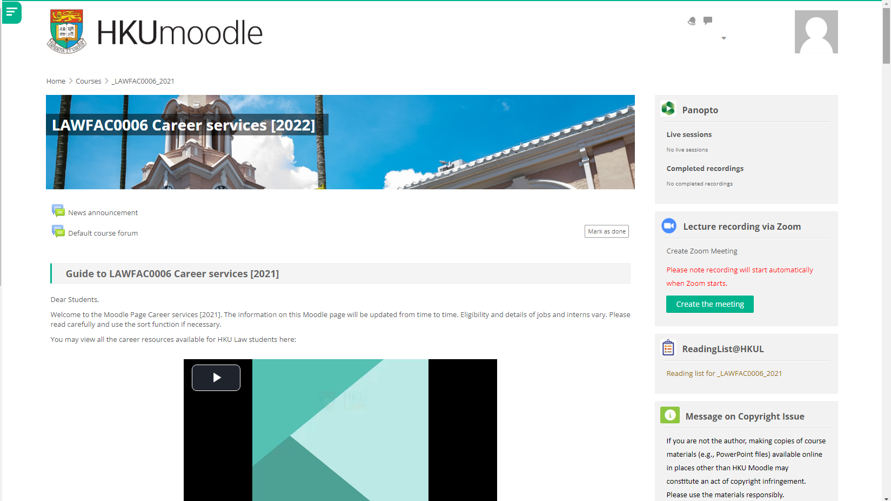
Moodle - LAWFAC0006 Career Services [2022]

Slide 2
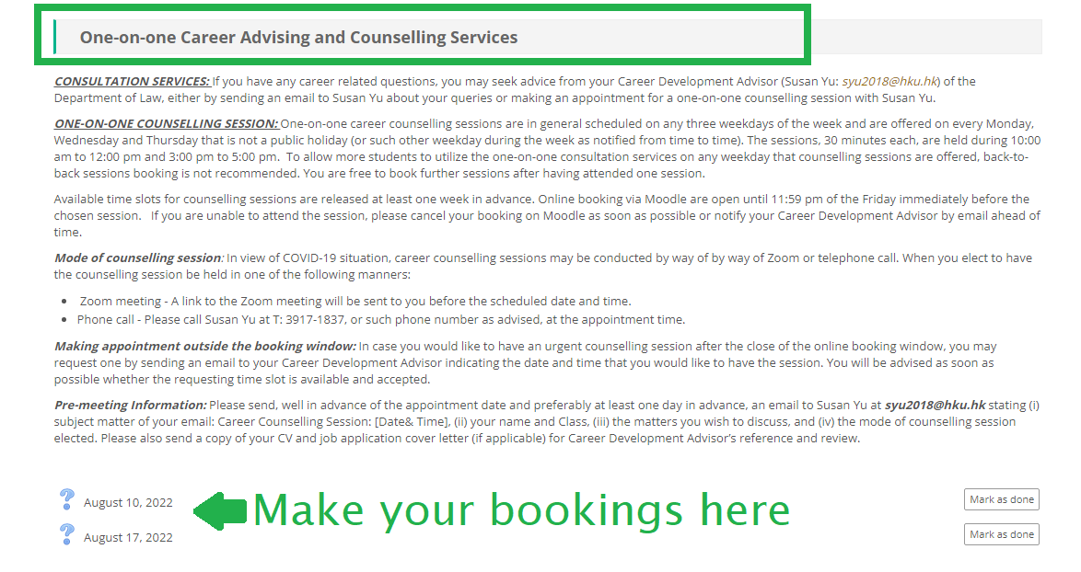
Visit LAWFAC0006 Career Services [2022] to make booking for the 30-minute career counselling session!

Slide 3
Career Resources for HKU Law Students

